Slide 1
SOAP APIs
Lecturer: Ngo Huy Bien
Software Engineering Department
Faculty of Information Technology
VNUHCM - University of Science
Ho Chi Minh City, Vietnam
nhbien@fit.hcmus.edu.vn

Slide 2

Objectives

Slide 3

Contents
SOAP Web Services
Service Bus Architecture (Web Services Platform Architecture)
SOAP Web Services Architecture

Slide 4

References
Hye-young Paik et al. (2017). Web Service Implementation and Composition Techniques. Springer.
Francisco Curbera et al. (2002). Unraveling the Web Services Web An Introduction to SOAP, WSDL, and UDDI.
M.P. Papazoglou (2003). Service-Oriented Computing.
Mark Endrei et al. (2004). Patterns - Service-Oriented Architecture and Web Services. IBM Corp.
Sanjiva Weerawarana et al. (2005). Web Services Platform Architecture. Prentice Hall PTR.
Gautam Shroff (2010). Enterprise Cloud Computing. Cambridge University Press.
Sanjiva Weerawarana et al. (2005). Web Services Platform Architecture. Prentice Hall PTR.

Slide 5
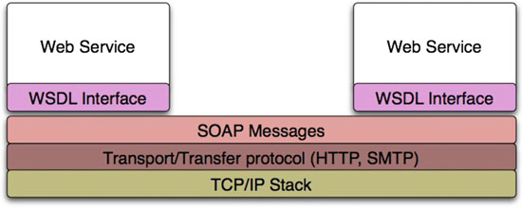
SOAP Web Services Overview [1]

Slide 6
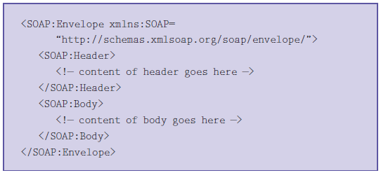
Simple Object Access Protocol (SOAP) [2]
SOAP is an XML-based protocol for messaging and remote procedure calls (RPCs).
Rather than define a new transport protocol, SOAP works on existing transports, such as HTTP, SMTP, and MQSeries.
A SOAP message has a very simple structure: an XML element with two child elements, one of which contains the header and the other the body.

Slide 7
Messaging Using SOAP
The request:
GET /StockPrice HTTP/1.1
Host: example.org
Content-Type: application/soap+xml; charset=utf-8
Content-Length: nnn
<?xml version="1.0"?>
<env:Envelope xmlns:env="http://www.w3.org/2003/05/soap-envelope"
xmlns:s="http://www.example.org/stock-service">
<env:Body>
<s:GetStockQuote>
<s:TickerSymbol>IBM</s:TickerSymbol>
</s:GetStockQuote>
</env:Body>
</env:Envelope>
The response:
HTTP/1.1 200 OK
Content-Type: application/soap+xml; charset=utf-8
Content-Length: nnn
<?xml version="1.0"?>
<env:Envelope xmlns:env="http://www.w3.org/2003/05/soap-envelope"
xmlns:s="http://www.example.org/stock-service">
<env:Body>
<s:GetStockQuoteResponse>
<s:StockPrice>45.25</s:StockPrice>
</s:GetStockQuoteResponse>
</env:Body>
</env:Envelope>

Slide 8
Tool for Calling Web Services
SoapUI
https://www.soapui.org/
https://base64converter.com/

Slide 9
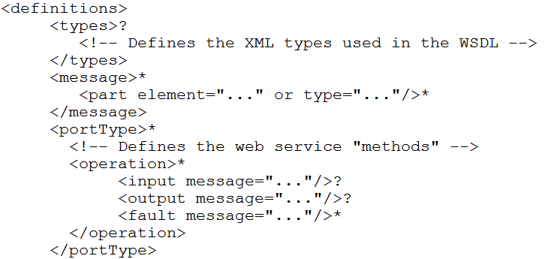
Web Services Description Language
The Web Services Description Language (WSDL) is an XML language for describing web services.
WSDL 1.1 has five major elements: types, message, portType, binding, and service.

Slide 10
Web Application Description Language
Web Application Description Language (WADL), is a specification developed to be an alternative to WSDL with specific support for RESTful web services.

Slide 11
Web Service [3]
A Web service is a specific kind of service that is identified by a URI, whose service description and transport utilize open Internet standards.
Interactions between Web services typically occur as SOAP calls carrying XML data content.
Interface descriptions of the Web services are expressed using Web Services Definition Language (WSDL).
The Universal Description, Discovery, and Integration (UDDI) standard defines a protocol for directory services that contain Web service descriptions.
UDDI enables Web service clients to locate candidate services and discover their details.

Slide 12
What is UDDI? [4]
The UDDI registry is often compared to the Yellow Pages of a telephone system.
Direct request: When you need to know the telephone number of a person, one of the easiest ways to get it is to request it from that person directly.
Simple aggregate publishing: When business people meet, they often exchange business cards. You need to have them printed in the first place, which adds some complexity over the direct request solution.
Directory use: It is only on some occasions that people refer to Yellow Pages; for example, to discover a service provider in a domain they are not familiar with.

Slide 13
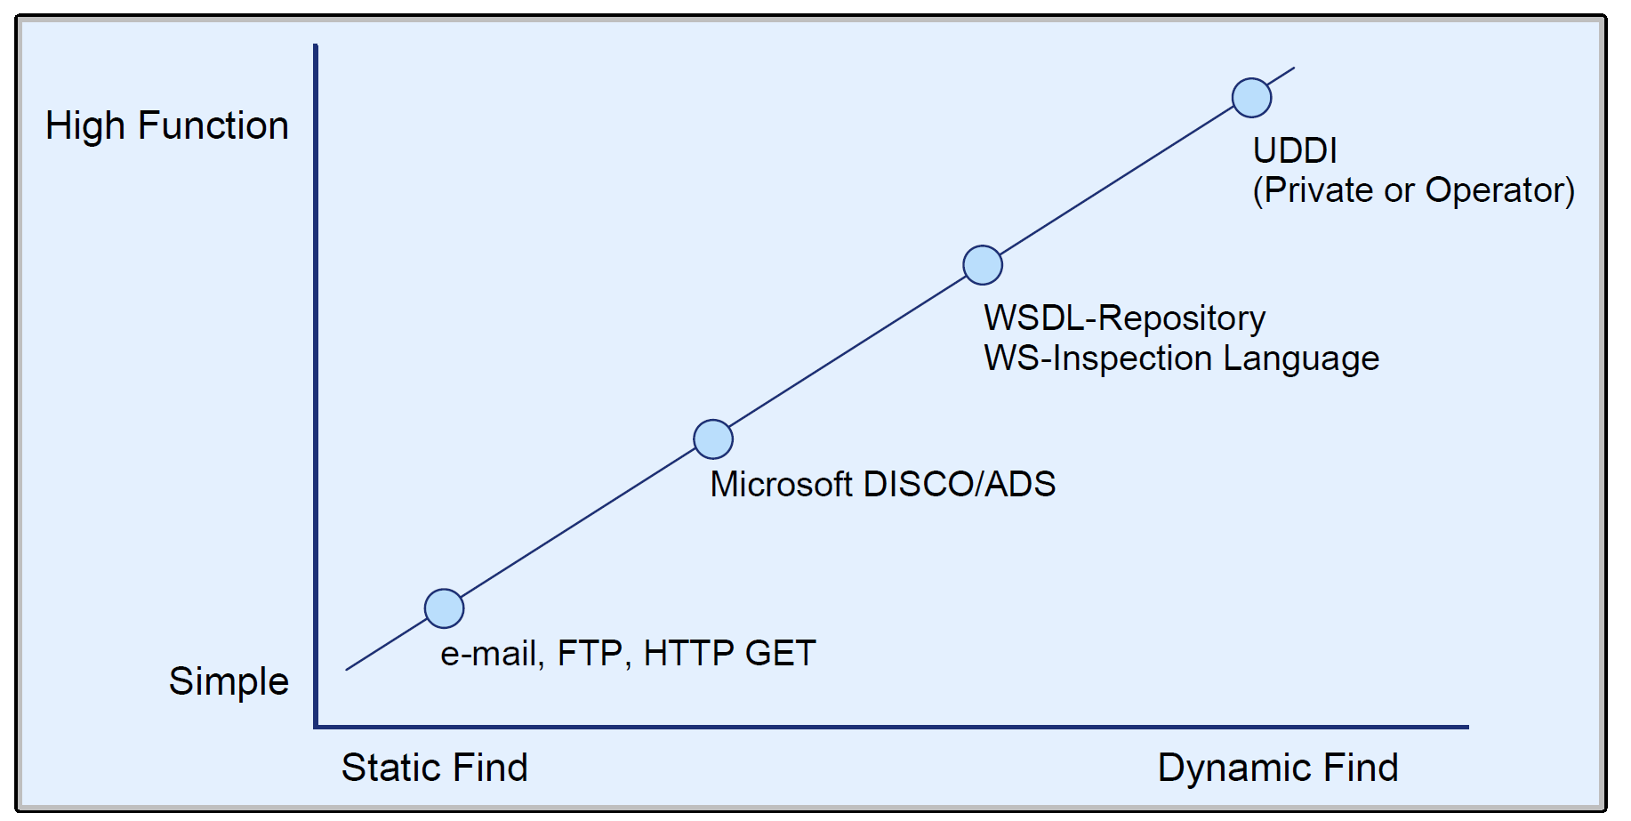
UDDI Analogy
The exchange of a service description on anything from an e-mail to a diskette can be compared to a direct request.
WS-Inspection Language can be compared to business cards.
The UDDI registries can be compared to Yellow Pages.

Slide 14
Why UDDI? [5]
One of the main benefits of a SOA is the ability to reuse services through the process of "service composition," the process in which existing services are assembled to create new services and applications. To realize this benefit, designers and developers need to know what existing services are available and how to interact with them.
A second benefit is the ability to dynamically select an implementation of a service at runtime. Either the application or the infrastructure that is hosting it can perform this selection. UDDI also enables service providers to publish their service implementations, and service users to find the one that provides the best match with their requirements.

Slide 15
SOAP/WSDL Web Services [6]
SOAP/WSDL web services evolved from the need to programmatically interconnect web-based applications.
SOAP/WSDL web services are essentially a form of remote procedure calls over HTTP, while also including support for nested structures (objects).
A client application can invoke this web service by sending a SOAP request in XML form.
The specifications of the service, including the service URL and other parameters, are made available by the service provider as another XML file, in WSDL format.
The client-server interface would be specified WSDL file, from which client and server stubs would be generated, along with libraries to handle complex data structures and data serialization across machine boundaries.

Slide 16
Tools for Creating SOAP APIs
Apache Axis https://axis.apache.org/
Windows Communication Foundation https://learn.microsoft.com/en-us/dotnet/framework/wcf/whats-wcf

Slide 17


Slide 18
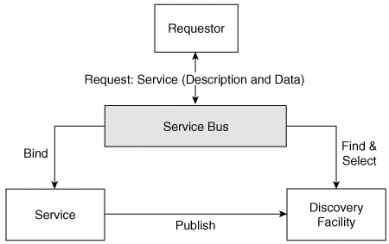
Service Bus in SOA [7]
A service bus provides a significantly improved ease-of-use experience for implementation of SOA. The bus
takes the service description and uses a discovery facility to find the list of qualifying services, selects one of them, retrieves the necessary binding information, binds the service accordingly,
transforms the input data from the requester properly, sends the corresponding request message to the service, receives the response, and passes this response in the proper format to the requester.

Slide 19
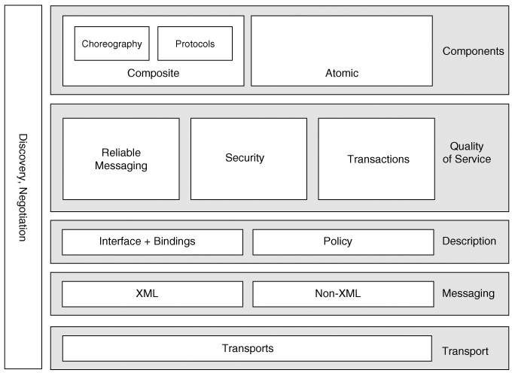
Service Bus Architecture

Slide 20
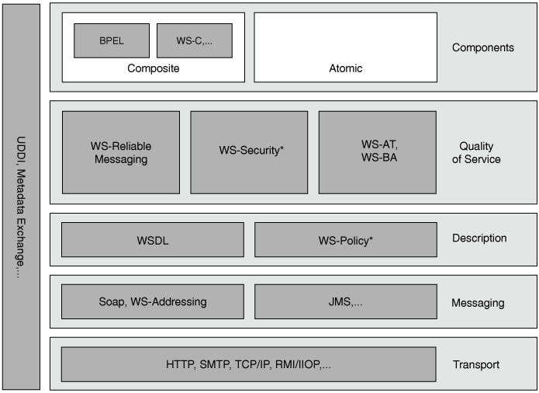
SOAP Web Services Architecture

Slide 21
WS-Addressing
WS-Addressing provides an interoperable, transport-independent way of identifying message senders and receivers that are associated with message exchange.
WS-Addressing decouples address information from the specific transport used by providing a mechanism to place the target, source, and other important address information directly within the Web service message.
WS-Addressing defines two fundamental concepts:
endpoint references as a general-purpose way of encoding the addressing information needed to reach service endpoints,
and message information headers to support the use of endpoint references in addressing and exchanging Web service messages.

Slide 22
Endpoint References
An endpoint reference is a data structure that is defined to encapsulate all the information that is required to reach a service endpoint at runtime.
An endpoint reference contains two types of information: runtime information required for the interaction with the endpoint, and associated metadata.
<wsa:EndpointReference>
<wsa:Address>http://www.example.com/stq</wsa:Address>
<wsa:ReferenceProperties>
<exp:customer-id>xgtopsnlk-0001<exp:customer-id> </wsa:ReferenceProperties>
<wsa:ReferenceParameters>
<exp:model-id>llp-11<exp:model-id>
</wsa:ReferenceParameters>
<wsa:PortType>tns:StockQuotePortType</wsa:PortType>
<wsa:ServiceName PortName="StockQuotePort">tns:StockQuoteService </wsa:ServiceName>
</wsa:EndpointReference>

Slide 23
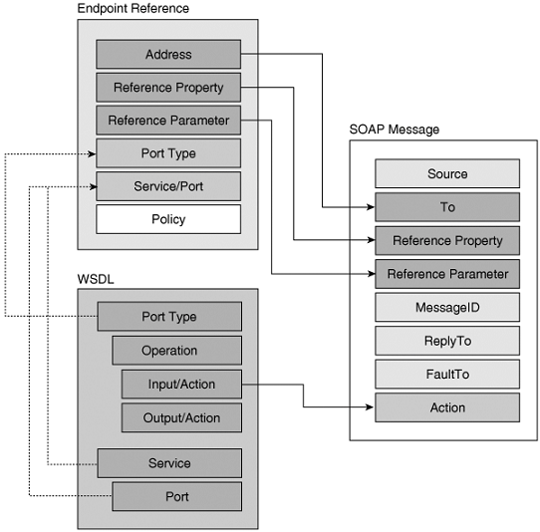
WS-Addressing in SOAP messages

Slide 24
WS-Policy Framework
The WS-Policy framework consists of two specifications: WS-Policy and WS-PolicyAttachment.
The WS-Policy specification describes the grammar for expressing policy alternatives and composing them as combinations of domain assertions.
The WS-Policy specification also describes the basic mechanisms for the merging of multiple policies that apply to a common subject and the intersection of policies to determine compatibility.
WS-Policy is critical to achieving interoperability at the higher-level functional operation of the service. Security, transactions, reliable messaging, and other specifications require concrete WS-Policy schema.
The WS-PolicyAttachment specification describes how to associate policies with a particular subject.

Slide 25
Attaching Policies to Web Services
In the context of Web services, policies describe the constraints on an interaction between two or more Web service endpoints typically a service provider and a service requester.
You create policy annotations using the PolicyURIs attribute or the PolicyReference element.
<binding name="stockQuoteSoapBinding"
type="tns:StockQuotePortType">
<soap:binding style="document"
transport="http://schemas.xmlsoap.org/soap/http"/>
<operation name="GetLastTradePrice">
<soap:operation soapAction="http://example.com/GetLastTradePrice"/>
<input>
<wsp:PolicyReference URI="http://www.example.com/StdSecurityPolicy1"/>
<soap:body use="literal"/>
</input>
<output>
<soap:body use="literal"/>
</output>
</operation>
</binding>

Slide 26
WS-Policy vs. WSDL
There is the benefit of clearly separating concerns, avoiding a single monolithic specification to deal with all the diversity of service description information.
WSDL has a clear focus on functional descriptions. Nonfunctional descriptions and quality of service aspects are naturally dealt with in a compose-able, reusable specification, such as WS-Policy.
Additional service description aspects, such as semantics, are best left to a different description language (such as OWL-S).
XML documents, stateful resources of every kind, reliable messaging sessions, and so on can be legitimate subjects on which policies will need to be asserted to ensure interoperability among services.
For this reason, WS-Policy strives to provide a flexible, extensible policy attachment mechanism for associating policies with subjects. WSDL is concerned only with service endpoints.
The flexibility of the attachment mechanism satisfies a third requirement that WSDL is not designed to support. That requirement involves representing the incremental addition of capabilities to an existing service. For example, confidentiality, authentication, support for reliable messaging protocols, and so on might be added to a service without impacting an application.

Slide 27
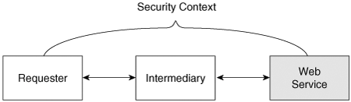
WS-Security
WS-Security uses existing security models (such as Kerberos and X509). The specifications concretely define how to use the existing models in an interoperable way.
WS-Security: SOAP Message Security provides support for end-to-end message security. This specification introduces three key concepts:
Security tokens SOAP messages can contain security tokens with authentication information. These tokens can flow with the message through intermediaries to vouch for message claims to downstream systems.
Signature elements SOAP messages can contain digital signature information for all or part of a message.
Encryption element SOAP messages can be encrypted, either wholly or in part.

Slide 28
WS-Trust
Security relies on predefined trust relationships. Kerberos works because participants trust the Kerberos Key Distribution Center. Public Key Infrastructure (PKI) works because participants trust the root certificate authorities.
WS-Trust defines an extensible model for setting up and verifying trust relationships.
The key concept in WS-Trust is a Security Token Service (STS). An STS is a distinguished Web service that issues, exchanges, and validates security tokens.
WS-Trust allows Web services to set up and agree on which security servers they trust, and to rely on these servers.
Participants often use WS-Security with public keys to start a conversation or session, and they use WS-SecureConversation to agree on session specific keys for signing and encrypting information.
WS-Federation allows a set of organizations to establish a single, virtual security domain.

Slide 29
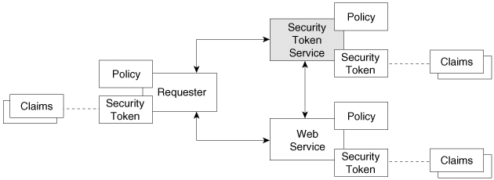
WS-Security Model
The requester might have claims regarding the message's security properties, such as identity and authorization claims.
WS-Security provides a way to represent the set of claims. This is represented as a security token, and WS-Security defines a standard XML format for transporting security tokens.
The implementing Web service has a set of requirements for a request to be accepted. These requirements are described as the service's policy, and in particular security policy, which is made known to the requester through UDDI or WS-MetadataExchange.
WS-Trust defines the interfaces to a Security Token Server.

Slide 30
WS-Security Processing Model
The processing model of WS-Security is built on top of the substrate provided by SOAP, XML Signature, and XML Encryption.
XML Signature protects parts of an XML document from unauthorized modifications using a cryptographic technique called digital signature.
The signature algorithm can be either a symmetric cryptosystem such as Triple DES and AES (Advanced Encryption Standard), or an asymmetric (public key) cryptosystem such as RSA and DSA.
XML Encryption encrypts portions of an XML document.
<ds:Signature>
<ds:SignedInfo>
<ds:CanonicalizationMethod Algorithm="..."/>
<ds:SignatureMethod Algorithm="..."/>
<ds:Reference URI="...">
<ds:Transforms> ... </ds:Transforms><ds:DigestMethod Algorithm="..."/>
<ds:DigestValue> ... </ds:DigestValue>
</ds:Reference>
</ds:SignedInfo>
<ds:SignatureValue> ... </ds:SignatureValue>
<ds:KeyInfo> ... </ds:KeyInfo><ds:Object> ... </ds:Object>
</ds:Signature>

Slide 31
WS-ReliableMessaging
WS-ReliableMessaging defines protocols that enable Web services to ensure reliable, interoperable exchange of messages with specified delivery assurances.
The specification defines three basic assurances:
In-order delivery The messages are delivered in the same order in which they were sent.
At least once delivery Each message that is sent is delivered at least one time.
At most once delivery No duplicate messages are delivered.
<soap:Envelope xmlns:soap="http://schemas.xmlsoap.org/soap/envelope/” xmlns:wsa="http://schemas.xmlsoap.org/ws/2004/08/addressing"
xmlns:wsrm="http://schemas.xmlsoap.org/ws/2005/02/rm">
<soap:Header>
<rm:Sequence>
<rm:Identifier>20030818-11010001-0500@example.com</rm:Identifier>
<rm:MessageNumber>1</rm:MessageNumber>
</rm:Sequence>
</soap:Header>
<soap:Body>…/soap:Body>
</soap:Envelope>

Slide 32
Transactions
WS-Coordination is a general mechanism for initiating and agreeing on the outcome of multiparty, multi-message Web service tasks.
WS-AtomicTransaction defines a specific set of protocols that plug into WS-Coordination to implement the traditional two-phase atomic ACID transaction protocols.
Application operations on Web services occur completely or not at all, and results are not available until the transaction is complete.
WS-BusinessActivity defines a specific set of protocols that plug into the WS-Coordination model to provide such long-running, compensation-based transaction protocols.
Application operations on Web services exhibit a loose unit of work, in which results are shared prior to completion of the overall activity. Each participant undoes the operations it has performed within the conversation.

Slide 33
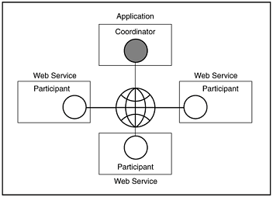
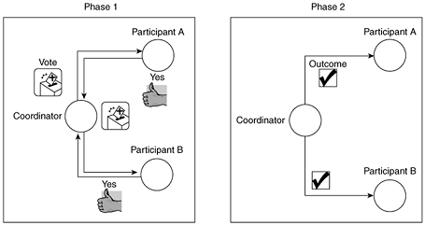
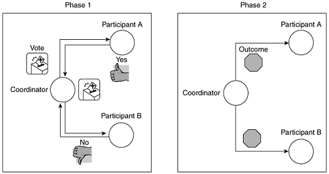
Classic Transaction
After returning the Phase 1 response, each participant who returns a Prepared response must remain blocked until it has received the coordinator's Phase 2 message.

Slide 34
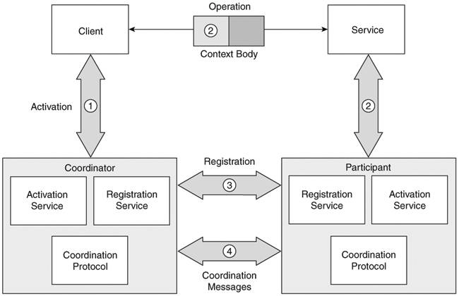
WS-Coordination

Slide 35
WS-Coordination Elements
Activation The WS-Coordination activation service creates a new activity and returns a context containing an identifier that uniquely distinguishes a particular work scope. Furthermore, activation defines the coordinator who is responsible for managing the coordination protocol processing and specifies the coordination protocols that are supported (WS-Coordination, CreateCoordinationContext).
Context The context that is returned at activation is passed along with the Web services operations and used to identify the operation as contained within the activity scope.
Registration The Web service that is receiving an operation with context might register for inclusion in the outcome processing that is associated with the activity completion. Further, the registration selects from the coordination protocols that are supported (WS-Coordination, Register).
Coordination Protocol A protocol service (such as WS-AtomicTransaction or WS-Business Activity) provides the logic to drive a specific completion-processing pattern.
The operations and messages for the services are defined using WSDL.

Slide 36
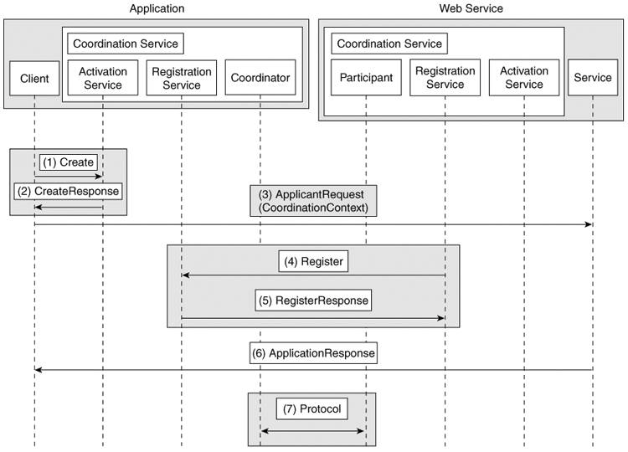
Web Service Transaction Flow

Slide 37
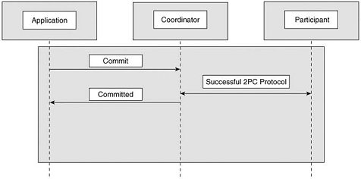
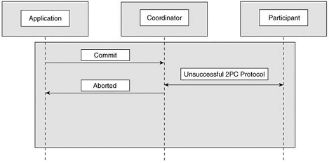
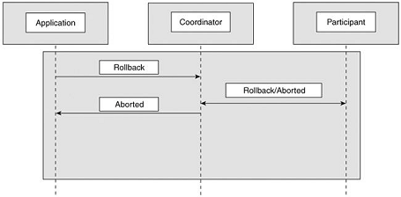
WS-Atomic Transaction: Completion Protocol

Slide 38
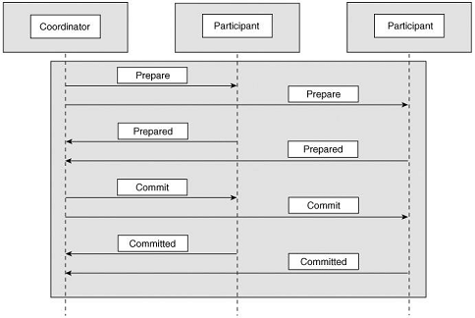
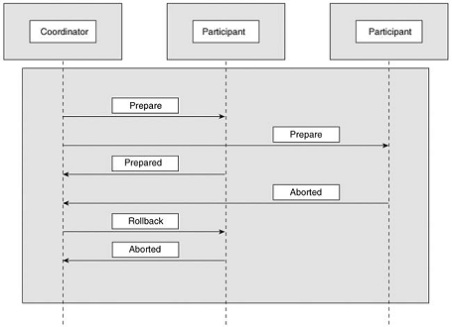
WS-Atomic Transaction: Durable Two-Phase Commit Protocol

Slide 39
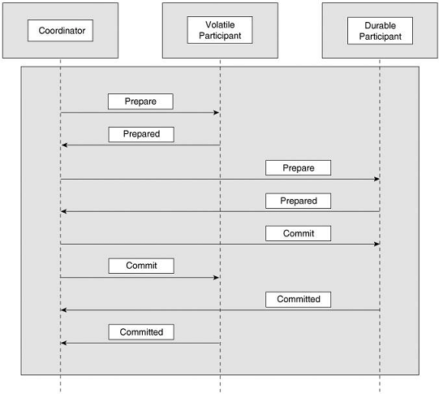
WS-Atomic Transaction: Volatile Two-Phase Commit Protocol

Slide 40

Thank You & See You Again

